Slide 1
Giant Magnetoresistance (GMR)
Rami Wail Shoula, 201600112
John Saber 201701287
Hassan Hassan 201700568
Ahmed Hashem 201700988

Slide 2
Outline
1- Introduction
2- History
3- Theory
4- Device, Materials and Methodologies
5- Applications
6- Conclusion
7- References

Slide 3
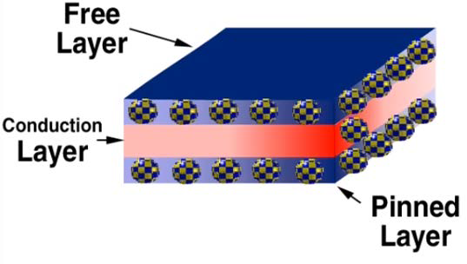
Introduction
Magnetoresistance is the change in the resistance of a material (any material) when it is placed in a magnetic field [1]
When a magnetic material such as iron is placed in a magnetic field, the change in the resistivity depends on the direction of the current flow with respect to the magnetic field
(GMR), occurs in certain special multilayer structures, which exhibit substantial changes in the resistance (e.g., more than 10 percent) when a magnetic field is applied.
Spring 2021, NANENG307, Lecture 6, Magnetic Materials, Dr. Shaimaa Ali

Slide 4
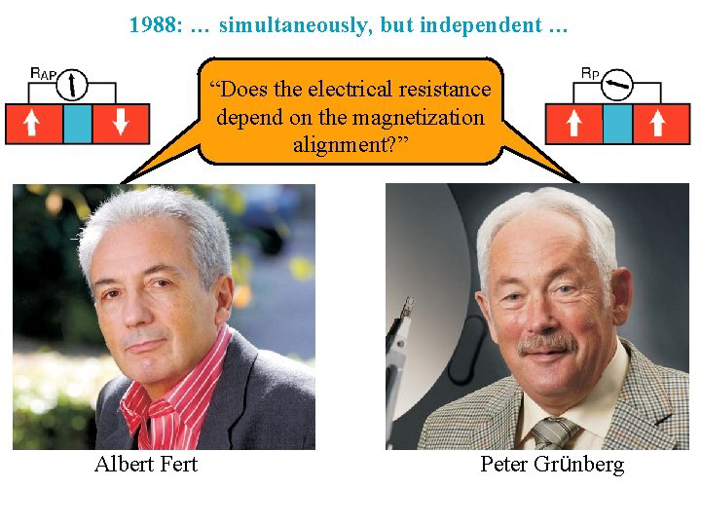
History
Magnetoresistance was well documented back to Lord Kelvin’s experiments in 1857 [1]
GMR was discovered in 1988 and was of the most influential impacts in development of magnetic devices
Peter Grünberg and Albert Fert were awarded the 2007 Nobel Prize “for the discovery of Giant Magnetoresistance”
GMR based devices include the read heads of hard disk drives and a wide range of magnetic field sensors.
Spring 2021, NANENG307, Lecture 6, Magnetic Materials, Dr. Shaimaa Ali

Slide 5
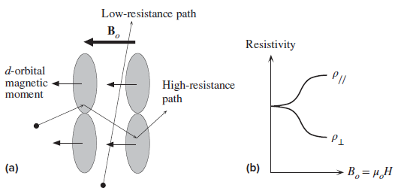
Theory
The basic principle of GMR is as follows:
The resistivity 𝝆// for current flow parallel to the magnetic field decreases
The resistivity 𝝆⟂ for current flow perpendicular to the field, increases by roughly the same amount.
(a) Principle of AMR. (b) Anisotropic resistivity effect
Applied field rotates the orbital angular momenta of the 3d electrons
Rotation alteres the scattering of conduction electrons in their respective paths of movement
Resistivity is dependent on flow direction against applied magnetic field
Kasap, S., 2018. Principles of electronic materials and devices. 4th ed. New York, NY: McGraw Hill Education.

Slide 6
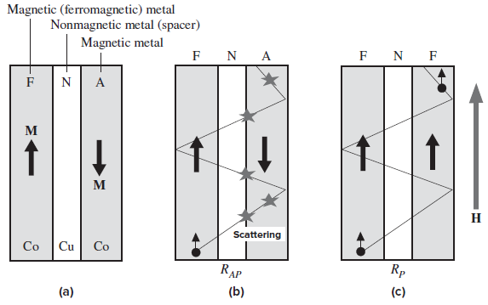
Device
These materials have a special multilayer structure composed of two ferromagnetic layers (Fe or Co or their alloys, etc.)
Separated by a nonmagnetic transition metal layer (such as Cu), called the spacer
Both magnetic layers are thin (less than 10 nm) with thinner nonmagnetic layer
These two layers are coupled indirectly through the thin spacer
Kasap, S., 2018. Principles of electronic materials and devices. 4th ed. New York, NY: McGraw Hill Education.

Slide 7

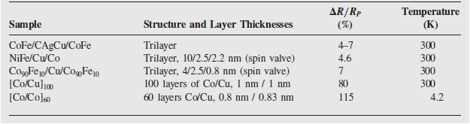

Materials and Methodologies
The two arrangements are:
FNA: antiferromagnetically coupled configuration
FNF: ferromagnetically coupled configuration
Where N stands for the nonmagnetic metal
Arrangements create a very large difference in their resistances
Antiparallel structure has much larger resistance RAP than parallel structure resistance RP
GMR effect is defined as:
Antiferromagnetic (left) and ferromagnetic (right) arrangements
GMR effect in trilayers and multilayers [2]
Kasap, S., 2018. Principles of electronic materials and devices. 4th ed. New York, NY: McGraw Hill Education.

Slide 8
Applications
GMR sensors indeed have attracted many researchers due to the widely used properties of the GMR as it is used in various applications because these sensors have not only high bandwidths but also sensitivity independent of the magnetic field[3].
One of the most common advantages is that GMR is well known for its small dimensions and that it requires a low power source.
Some main applications will be discussed
1- Spin Valve Sensors
2- Hard Disk Drivers
3- Other Applications

Slide 9
Spin Valve Sensors
A typical GMR-based sensor consists of seven layers[4]:
Silicon substrate.
Binder layer which is made of tantalum
Sensing (non-fixed) layer made of NiFe or cobalt alloys. However the magnetization can be reoriented by the external magnetic field as mentioned before.
Non-magnetic layer which can be made of copper
Fixed layer is made of a magnetic material such as cobalt.
Antiferromagnetic (Pinning) layer. The FeMn or NiMn can be used
Lastly the Protective layer is made made of tantalum

Slide 10
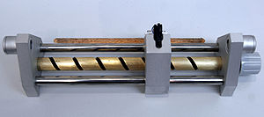
A copy of GMR sensor developed by peter Grünberg[4]
Kools, J.C.S. Exchange-biased spin-valves for magnetic storage. IEEE Trans. Magn. 1996, 32, 3165–3184.

Slide 11
Hard disk drives
It is known that the information In hard disk drives (HDDs) is encoded using the change in magnetic domains. The magnetization change is associated with the logical level 1 while no change represents logical 0.
In the current technology there are 2 main recorded methods: longitudinal and perpendicular.
The magnetization is expected to be normal to the surface In case of longitudinal method. As studied there exist transition regions called domain walls which formed between the magnetic domains, in which the magnetic field direction changes inside the material.
Now in order to read the magnetic field direction just above the magnetic domain wall, assume that the magnetization direction’s direction is fixed normal to the surface in the antiferromagnetic layer and parallel to the surface in the sensing layer. [5]
Changing the direction of the external magnetic field deflects the magnetization in the sensing layer. And so the electrical resistance of the sensor decreases, and So on.

Slide 12
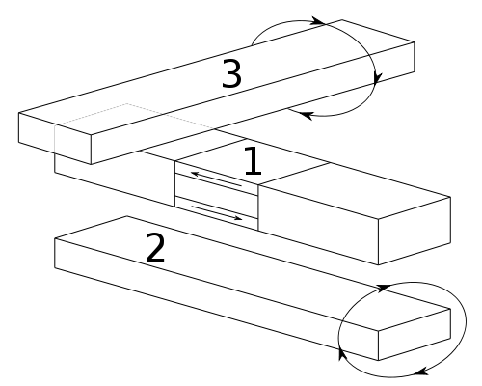
The use of Spin Valve in MRAM[5]
Lenssen, K.M.H.; Adelerhof, D.J.; Gassen, H.J.; Kuiper, A.E.T.; Somers, G.H.J.; van Zon, J.B.A.D. Robust giant magnetoresistance sensors. Sens. Actuators A Phys. 2000, 85, 1–8.

Slide 13
Other Applications:
Magnetic RAM: A MRAM (magnetoresistive random-access memory) has a similar structure to the spin-valve sensor mentioned before. The general principle can be summarized that the encoded bits are made by the magnetization direction in the sensor layer. Moreover, it is applicable to measure the resistance of the structure.
Magnetoresistive insulators for contactless signal transmission

Slide 14
Conclusion
The effect of GMR is well observed as a change in the electrical resistance depending on the magnetization, also depending on the alignment of the ferromagnetic layers whether they are in a parallel or an antiparallel alignment.
From this review, we can conclude that the total resistance is relatively high for antiparallel alignment and so it is relatively low for parallel alignment
Also we can control the direction of the magnetization by applying an external magnetic field
Many researchers got attracted to GMR sensors because they are used in various applications as they have high bandwidths and sensitivity independent of the magnetic field.

Slide 15
References
[1] Kasap, S., 2018. Principles of electronic materials and devices. 4th ed. New York, NY: McGraw Hill Education.
[2] Grünberg, P., Sensors and Actuators A, 91, 153, 2001.
[3] Rifai, D.; Abdalla, A.N.; Ali, K.; Razali, R. Giant Magnetoresistance Sensors: A Review on Structures and Non-Destructive Eddy Current Testing Applications. Sensors 2016, 16, 298. https://doi.org/10.3390/s16030298
[4] Kools, J.C.S. Exchange-biased spin-valves for magnetic storage. IEEE Trans. Magn. 1996, 32, 3165–3184.
[5] Lenssen, K.M.H.; Adelerhof, D.J.; Gassen, H.J.; Kuiper, A.E.T.; Somers, G.H.J.; van Zon, J.B.A.D. Robust giant magnetoresistance sensors. Sens. Actuators A Phys. 2000, 85, 1–8.

